Slide 1



CoVShorts: News Summarization Application Based on Deep NLP Transformers for SARS-CoV-2
Teacher Mentors:
Ms. Deepali Bajaj
Ms. Urmil Bharti
Mentee:
Akansha Jain
Gargi Bisht
Khushi Srivastava
Meenakshi Bharadwaj
Notes:
Good Morning! Today, I ,Khushi Srivastava along with my team members, am going to present our project on CoVShorts : News Summarization Application Based on Deep NLP Transformers for SARS-CoV-2.

Slide 2
OUTLINE
Background
Contributions
Implementation
NLP Model Selection
CoVShorts Web Application
Blueprint
Architecture
User Interface
ROUGE Score
Results
Summary
References
Notes:
Let’s start with presentation
Now, We will be discussing the background of our project, what was the idea and motivation behind coming with this web application and what was our approach towards achieving it. Subsequently, We will discuss how our project is contributing novelty to existing work. Then We will present the entire process for the implementation. Finally, we will go through the evaluation method and the results of our project.

Slide 3
BACKGROUND
As 2020, hit the SARS-CoV-2 global pandemic, brought with it an abundance of research publications, news articles, etc., related to it and made it difficult to read through all of the data.
Our Objective: To develop a platform to summarise elongated and verbose news articles, related to the coronavirus pandemic, into precise articles containing only the relevant facts
NLP serves with Pre-trained transformer-based models that can be used to generate summaries that retain the overall sense of the articles.
Notes:
In 2020, the rapid rise in COVID-19 has impacted individuals all over the world. The pandemic has brought with it an abundance of research publications, news articles, etc., making it difficult for the general public to keep up with all of the information and read through all of the data. Short summaries of news articles can assist the public in grasping a gist of an entire article without having to read it completely. So we thought of developing a platform which can summarise lengthy news articles, related to the coronavirus pandemic, into precise articles.
With the evolution of Deep Learning in Natural Language Processing, we exploited the power of recent advances in pre-trained transformer-based NLP models to perform text summarization over the COVID-19 Public Media Dataset. NLP serves with models that can be used to generate summaries that retain the overall sense of the articles.

Slide 4
BACKGROUND
Automatic Text Summarisation
Automatic text summarisation techniques can be divided into two different approaches: Extractive and Abstractive.
Extraction-based Summarization
The extractive approach involves picking up the most important phrases and lines from the documents. It then combines all the important lines to create the summary. So, in this case, every line and word of the summary actually belongs to the original document which is summarized.
Abstraction-based Summarization
The abstractive approach involves summarization based on deep learning. So, it uses new phrases and terms, different from the actual document, keeping the points the same, just like how we actually summarize. So, it is much harder than the extractive approach.
Notes:
Automatic text summarisation techniques can be divided into two different approaches: Extractive and Abstractive.
In extractive text summarization, transformer models locate and concatenate the parts of the sentences that seem more relevant for the summary. So, in this case, every line and word of the summary actually belongs to the original document which is summarized.
Abstractive text summarization has a different approach which parses the source text to provide summaries with novel terms or phrases not from the source content.just like how we actually summarize. So, it is much harder than the extractive approach.

Slide 5
CONTRIBUTIONS
01
3 models perform extractive text summarization while 2 perform abstractive text summarization.
One of the extractive models is an auto-encoder and the other two are autoregressive models.
Both the abstractive models are Seq2Seq transformer models.
Selected and tested 5 NLP transformer models for summarization of COVID-19 news articles.
02
The web application was designed using Flask to provide users a platform to perform news article text summarization.
Best performing model, BERT, was deployed in the web application.
Designed a web application named “CoVShorts: SARS-CoV-2 News Summarization”.
03
ROGUE scores (ROUGE-2 and ROUGE-L) are calculated for summaries generated on a dataset for all 5 models.
World Cloud is generated to ensure summaries don’t deviate from COVID-19 topic.
Validation done using two methods for most favourable results.
Notes:
What makes our project unique is its contributions.
Number 01: Firstly To analyze the performance of different kinds of summarization, we selected 5 NLP transformer models. 3 models, namely GPT-2, BERT and XLNet, perform extractive text summarization. In addition, GPT-2 and XLNet are autoregressive models whereas BERT is an auto-encoder.
The other 2 models are T5 and BART which perform abstractive text summarization. They both are Seq2Seq transformer models.
Number 02: Our tests show that BERT provided with the best summaries for COVID-19 news articles so we deployed it in our web application named “CoVShorts” where long news articles can be condensed into summaries. The objective of our project is to develop a platform for users where long news articles can be condensed into summaries containing only the relevant facts from the article to ease out staying up-to-date.
Number 03: COVID-19 is a new arena for researchers and so any work related to it should be doubly-checked for assurance. We evaluated the summaries generated by calculating ROUGE scores ( ROUGE-2 and ROUGE-L). BERT getting highest ROUGE score assured that it was providing a summary most similar and relevant to the news article. We further generated a WORD CLOUD for the summaries to reassure that they did not deviate from the topic of the article.
Now I would like to invite Akansha to take over the presentation from here.

Slide 6
IMPLEMENTATION
DATASET
PREPROCESSING
The “COVID-19 Public Media Dataset” employed, was obtained from Anacode's Kaggle platform. Between January 1 and December 31, 2020, this dataset acquired over 350,000 full-text internet articles from online media. This dataset is a collection of non-medical news articles about SARS-CoV-2 collected from more than 60 popular blogs and news sites. The news sources used to compile articles for the corpus span a variety of media categories, with the goal of presenting a representative cross-section of online content published and accessed during that time period.
According to the findings of several recent research, preprocessing a dataset can enhance the accuracy of outcomes by 2%. During the preparation stage, we improved the dataset by first lowercasing it and then removing punctuation marks, meaningless words, misspellings, or phrases like HTML elements (which were included in the dataset while scraping data from websites) and embedded links.
Notes:
We tested the 5 models on “COVID-19 Public Media Dataset” which was obtained from Anacode's Kaggle platform. Between January 1st and December 31st, 2020, this dataset acquired over 3 lakh 50 thousand full-text internet articles from online media. This dataset is a collection of 3 lakh 50 thousand non-medical news articles about SARS-CoV-2 collected from more than 60 popular blogs and news sites. The news sources used to compile articles for the corpus span a variety of media categories, with the goal of presenting a representative cross-section of online content published and accessed during that time period.
According to the findings of several recent research, preprocessing a dataset can enhance the accuracy of outcomes by 2%. During the preparation stage, we improved the dataset by first lowercasing it and then removing punctuation marks, meaningless words, misspellings, or phrases like HTML elements (which were included in the dataset while scraping data from websites) and embedded links.

Slide 7
NLP MODEL SELECTION
NLP MODELS | DESCRIPTION
BERT | Bidirectional Encoder Representations from Transformers (BERT) : a neural network-based methodology for pre-training NLP. An autoencoder-based transformer (uses only the encoder block of the transformer). Uses self-attention on the encoder side and attention on the decoder side.
GPT-2 | Generative Pre-trained Transformer 2 (GPT-2), an autoregressive transformer model, is an open-source artificial intelligence model developed by OpenAI. A language model with 1.5 billion parameters trained on a dataset of 8 million Web pages. Developed using transformer decoder blocks, has 4 model sizes consisting of different architectural hyperparameters - small, medium, large, and XL, with 124M, 355M, 774M, 1.5B parameters. Includes 1024 tokens and a vocabulary of 50,257 words.
XLNet | XLNet uses non-traditional autoregressive training technique. Before permitting the model to predict the token n+1 based on the last n tokens, it permutes the tokens in the sentence. Rather than masking the first n tokens for n+1, XLNet provides a net that masks the preceding tokens in a certain permutation of 1, 2,..., Sequence Length. Most significant change in XLNet : the language model training, which now seeks to learn conditional distributions for all permutations of tokens in a sequence.
Notes:
Now, I will briefly describe all the 5 models that we have used. These are Bert, GPT-2, XLNet, T5 and Bart. Firstly, we will be discussing the extractive text summarization models. Starting with Bert.
BERT, which stands for Bidirectional Encoder Representations from Transformers, is a neural network-based technique for natural language processing pre-training. It BERT is basically an Encoder stack of transformer architecture. A transformer architecture is an encoder-decoder network that uses self-attention on the encoder side and attention on the decoder side. For example, in the phrases “nine to five” and “a quarter to five,” the word “to” has two different meanings, which may be obvious to humans but less so to search engines. BERT is designed to distinguish between such nuances to facilitate more relevant results.
Moving on, we used Generative Pre-trained Transformer 2 also known as GPT-2. It is an open-source artificial intelligence created by OpenAI in February 2019. It Moving on, GPT-2 translates text, answers questions, summarizes passages, and generates text output on a level that, while sometimes indistinguishable from that of humans, can become repetitive or nonsensical when generating long passages. It is a large transformer-based language model with 1.5 billion parameters, trained on a dataset of 8 million of Web pages. It is trained with a simple objective, that is to predict the next word, given all of the previous words within some text.
The difference between both these models is that BERT has just the encoder blocks from the transformer, whilst GPT-2 has just the decoder blocks from the transformer.
Our third extractive model is XLNet. It is an auto-regressive language model which outputs the joint probability of a sequence of tokens based on the transformer architecture with recurrence. Its training objective calculates the probability of a word token conditioned on all permutations of word tokens in a sentence, as opposed to just those to the left or just those to the right of the target token. XLNet's main contribution is not the architecture, but a modified language model training objective which learns conditional distributions for all permutations of tokens in a sequence.

Slide 8
NLP MODEL SELECTION
NLP MODELS | DESCRIPTION
T5 | Text-To-Text Transfer Transformer (T5) : a pre-trained language model stands out for using a unified “text-to-text” format for all text-based NLP tasks. Was first proposed by Vaswani et al. (2017) [18], where initially each task was converted to text-to-text format and then pre-trained on a variety of supervised and unsupervised activities. This method is well-suited for generative tasks (such as machine translation or abstractive summarization) in which the model must generate text based on some input.
BART | Bidirectional and Auto-Regressive Transformer (BART), a denoising autoencoder : used for pre-training sequence-to-sequence models. Like the original Transformer model for neural machine translation, but with some differences from BERT (which only uses the encoder) and GPT (which only uses the decoder). Pre-training task entails changing sequence of original phrases at random and using a novel in-filling strategy that replaces text spans with a single mask token. Trained by corrupting text using a random noising function and then building a model to recover the original text.
Notes:
Now, let’s talk about the abstractive text summarization models T5 and BART.
T5 also stand for Text-To-Text Transfer Transformer which T5 is a pre-trained language model that stands out for using a unified “text-to-text” format for all text-based NLP tasks. It was first proposed by Vaswani and others in 2017, where Initially each task was converted to text-to-text format and then pre-trained on a variety of supervised and unsupervised activities. This method is well-suited for generative tasks (such as machine translation or abstractive summarization) in which the model must generate text based on some input.
Now, let’s discuss about BART. BART also stands for Bidirectional and Auto-Regressive Transformer, BART is a denoising autoencoder which is used for pre-training sequence-to-sequence models. A Denoising Autoencoder is a modification on the autoencoder to prevent the network learning the identity function. Specifically, if the autoencoder is too big, then it can just learn the data, so the output equals the input, and does not perform any useful representation learning or dimensionality reduction. BART is like the original Transformer model for neural machine translation, but with some differences from BERT (which only uses the encoder) and GPT (which only uses the decoder).

Slide 9
BLUEPRINTS FOR COVSHORTS
ELEMENTS OF CoVShorts APPLICATION | SOFTWARE PRODUCTS AND FRAMEWORKS
Front-end Technologies | HTML (Hypertext Markup Language) CSS (Cascading Style Sheet)
Backend Technologies | Flask Web Framework
Coding and Testing | Google Colaboratory
Libraries | HuggingFace Pytorch transformers library to run summarizations ROUGE-SCORE, a library for ROUGE-score calculation.
Notes:
As we mentioned earlier, we deployed the best performing model in our web application named “CoVShorts: SARS-CoV-2 News Summarization”.
For our web application:
HTML and CSS were employed as front-end technologies.
For back-end technology, we used the Flask web framework, and for coding and testing, we used Google Colab.
Hugging Face Pytorch transformers library and ROUGE score library are among the libraries imported.
The elements for building this application are-
Firstly, we used HTML and CSS as the front-end technologies for designing the User Interface of the application then
to deploy the best-performing model in our application, we leveraged Flask Web framework as backend technology.
We utilised Google Colab, for Coding and Testing the models,
and finally, the libraries that we imported were-
a) Hugging Face Pytorch transformers library: A library of state-of-the-art pre-trained NLP models for executing model summarization.
b) ROUGE-SCORE: A library for ROUGE-score calculation to evaluate the performance of the models.

Slide 10
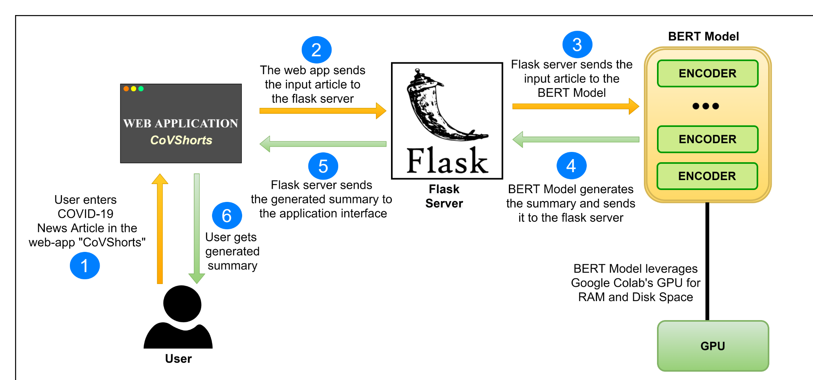
COMPLETE ARCHITECTURE OF COVSHORTS
Notes:
Now, let’s talk about the architecture of Our Application. We designed CoVShorts web application using Flask, a micro web framework. We deployed BERT, the best performing pre-trained NLP transformer model in our application. We powered our application by leveraging Google Colab GPU environment.
Here is how it works, First, User will enter a news article related to the COVID-19 as input. Second, the Application sends the input article to the flask server. Then, the Flask server sends it to the deployed model, BERT, and then BERT, by leveraging Google Colab’s GPU for RAM and disk space, will generate the summary and sends it to the flask server.
Flask server sends the summary generated to the CoVShorts interface and then finally, the summary is displayed on the Tab, hence, user gets the generated summary.

Slide 11
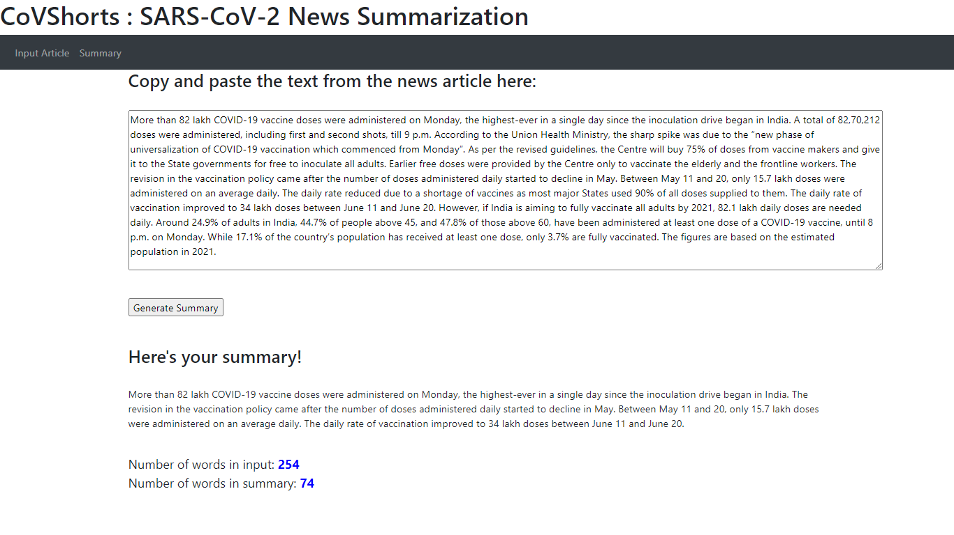
COVSHORTS USER INTERFACE
CoVShorts leverages BERT to generate summaries.
Summary generated is precise.
The number of words in the actual article and that in the summary has a huge difference.
User Interface of “CoVShorts” Web application for News article summarization
Notes:
This is the User Interface of CoVShorts Application, wherein the input article is given by the user, and a button to generate summary. On clicking the button, the application processes the article and returns the summary which is displayed in the summary section.
Also, we can see the efficiency of the CoVShorts by the difference in the number of words in the input article and in the generated summary.

Slide 12
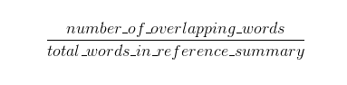
ROUGE SCORE
ROUGE stands for Recall-Oriented Understudy for Gisting Evaluation. It works by comparing an automatically produced summary or translation against a set of reference summaries which are commonly human-generated.
Computes both the precision and recall and then reports the F-Measure.
Recall (in the context of ROUGE) refers to how much of the reference summary the system summary is recovering or capturing.
Recall =
Notes:
There are many scoring algorithms available for text summarization evaluation, like, BLUE score, ROUGE score.
As ROUGE is more preferred in summarization tasks, we have used ROUGE score for our Text Summarization Evaluation. Unlike BLEU, ROUGE is recall-oriented, meaning that it prioritises recall over precision, whereas BLEU prioritises precision
ROUGE(or Recall-Oriented Understudy for Gisting Evaluation) is a software package and metric set that determines the qualities of the translation or generated summary by comparing it to the human-generated summary or reference summary..
It computes both the precision and recall and then reports the F-Measure.
In the context of ROUGE, Recall refers to how much of the reference summary the system summary is recovering or capturing.

Slide 13
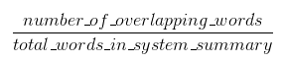
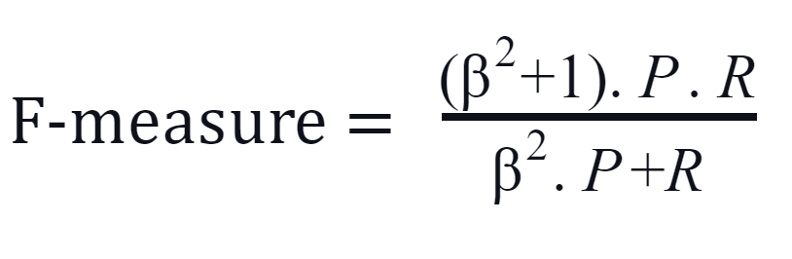
ROUGE SCORE
Precision (in the context of ROUGE) helps to understand whether the summary generated might have useless words making it unnecessarily verbose. Precision essentially measure what amount of the system summary was relevant and in fact needed.
F-measure is a parameter which combines both precision and recall in the following manner
where β is a weighting parameter that favours precision when chosen greater than 1 and recall when smaller than 1.
Precision =
Notes:
In the context of ROUGE, Precision helps in determining whether the generated summary contains unnecessary words that might be making it overly verbose.
It essentially measures what amount of the system summary was relevant and in fact needed.
F-measure: It is a parameter which combines both precision and recall in the following manner
where β is a weighting parameter that favours precision when chosen greater than 1 and recall when smaller than 1.
I would like to Invite Gargi to discuss the results we obtained. Over to you Gargi.

Slide 14
RESULTS
The evaluation results of selected five pre-trained NLP models based on ROUGE scores.
Absence of open-source datasets for COVID-19 news articles with gold standard summaries led us to use input-summary similarity.
Experiment results show that extractive summarization models such as GPT-2, BERT, and XLNet outperform the other two abstractive models T5 and BART in terms of performance and speed.
In the end, BERT proved that it is straightforward and experimentally dominant in comparison to all other summarization models.
MODEL | ROUGE-2 | ROUGE-L
GPT-2 | 0.348 | 0.358
BERT | 0.354 | 0.364
XLNet | 0.343 | 0.352
T5 | 0.158 | 0.163
BART | 0.167 | 0.172
Notes:
Moving forward with the results, the evaluation of selected five pre-trained NLP models were based on ROUGE scores, as mentioned earlier..
COVID-19 is a new field of study for automatic text summarization using NLP. Since COVID-19 is a new field of study there were no open-source datasets for COVID-19 news articles with gold standard summaries that could be used for evaluation of automatic text summarization. As a result, we used the concept of input-summary similarity to solve this problem in our work. The underlying intuition is that good summaries will tend to be similar to the input in terms of content. Both ROUGE-2 and ROUGE-L scores were compared between the summary generated by CoVShorts and its article as the reference summary in our experiments.
We extracted 800 news articles from the COVID-19 Public Media Dataset for testing the performance of the chosen models. As Google Colab has a limited amount of RAM and storage space, the dataset was split into eight subsets, each with a size of 100 articles. Then for each set, we calculated the ROUGE-2 and ROUGE-L cumulative F measure scores for all five respective models.

Slide 15
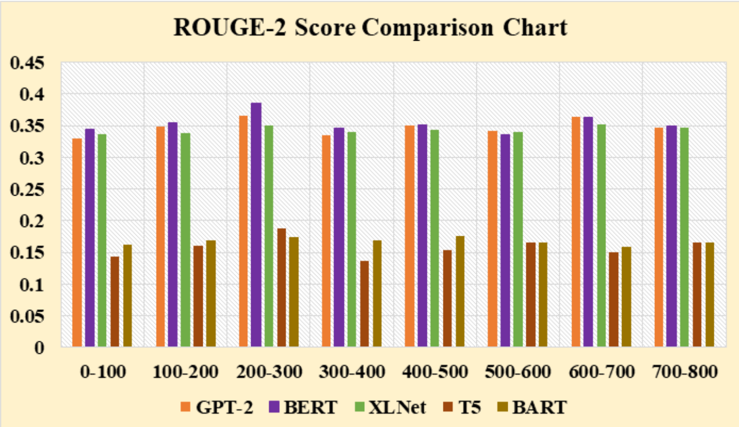
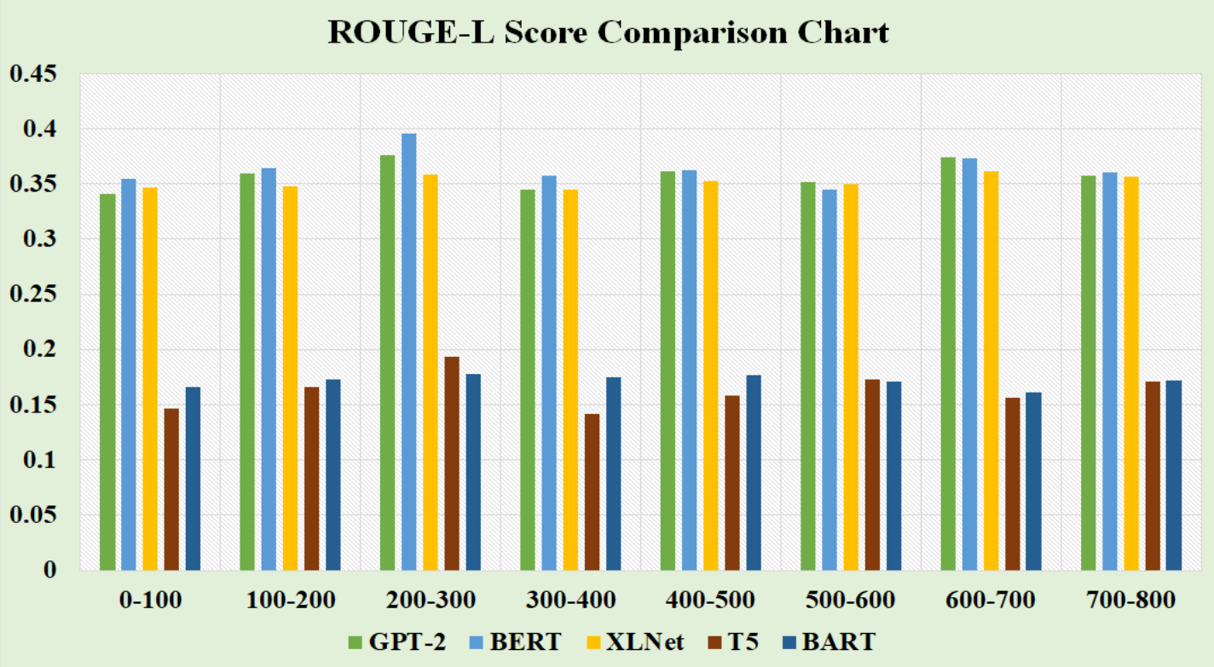
RESULTS
Comparison of cumulative (a) ROUGE-2 F-measure (b) ROUGE-L F-measure, for 800 news article samples from the dataset[11] using GPT-2, BERT, XLNet, T5, and BART models
From Figure, we can articulate that there is a tough fight amongst the three models namely GPT-2, BERT, and XLNet; BERT is performing well whereas T5 and BART are lagging. Hence, BERT proved that it is straightforward and experimentally dominant in comparison to other summarization models.
Notes:
Experiment results showed that extractive summarization models such as GPT-2, BERT, and XLNet outperformed the other two models, as shown in the table here. We can say that the three models, GPT-2, BERT, and XLNet, are competing fiercely; BERT is outperforming the others, while T5 and BART lags. Hence, BERT demonstrated that it is simple and experimentally dominant in comparison to other summarization models.

Slide 16
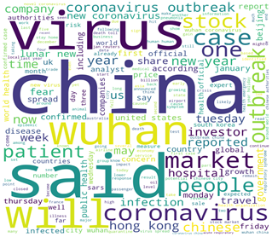
RESULTS
Word Cloud is used to assess the quality of CoVShorts summaries. In word cloud, the size of each word depends upon the frequency or the total number of times the word appeared. Here, it delivers an "overall image" of the summaries produced by BERT.
Notes:
We used Word Cloud to validate the CoVShorts summary. It is an effective visualisation technique for representing the frequency of words in a text in a simple and captivating way. It exhibits the graphical representation of the data obtained from the text. The size of each word is determined by its frequency,or the total number of times it appeared. The Word Cloud is also used on our dataset to find the most frequently occurring words in the summaries generated by BERT. Word CLoud assisted us in determining whether the generated summaries captured the essence of the COVID-19 topic or not.

Slide 17
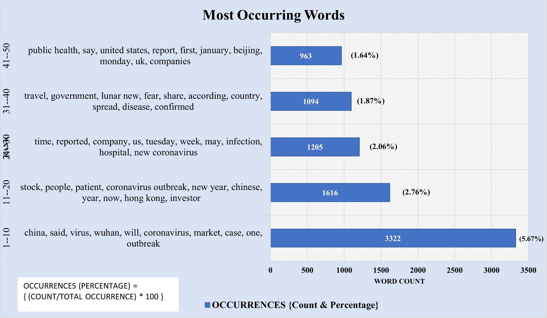
The above graph shows that the most frequently appearing keywords, indicating that the summaries produced by BERT do not deviate from the COVID-19 theme .
Notes:
As we can see in the graph above, the most frequent keywords that appears in the summaries generated by BERT are china, virus, wuhan, outbreak, coronavirus, cases . This indicates that they are not straying away from the COVID-19 theme.

Slide 18
FUTURE WORK
01
Can be used as a plugin to other applications for text summarization.
02
Summary generation on a page using Web Scraping on a link entered by the user.
03
Various other NLP models can also be incorporated.
Notes:
In future, this project could be taken a step further by developing a mobile application for the user's convenience. In addition, rather than pasting the news article as input, the user can directly enter the URL for the news article, and the application will extract the article for summarization. To generate even better summaries, various other NLP models can also be incorporated.

Slide 19
SUMMARY
Overall, the extractive NLP models outperformed the abstractive ones.
An auto-encoding model (BERT), provided better results than the autoregressive (XLNet, GPT-2) and Seq2Seq-based other proposed models (BART,T5).
BERT, an extractive text summarization model, produced the summary with the highest ROUGE score out of all the models tested.
Hence, we deployed BERT, the best performing pre-trained NLP transformer model in our application “CoVShorts”.
We confirmed, using Word Cloud, that the summary generated by CoVShorts is concise and does not deviate from the actual theme of the news article.
Notes:
Overall, the extractive NLP models outperformed the abstractive ones.
An auto-encoding model (BERT), provided better results than the autoregressive (XLNet, GPT-2) and Seq2Seq-based other proposed models (BART,T5).
BERT, an extractive text summarization model, produced the summary with the highest ROUGE score out of all the models tested.
Hence, we deployed BERT, the best performing pre-trained NLP transformer model in our application “CoVShorts”.
We confirmed, using Word Cloud, that the summary generated by CoVShorts is concise and does not deviate from the actual theme of the news article.

Slide 20

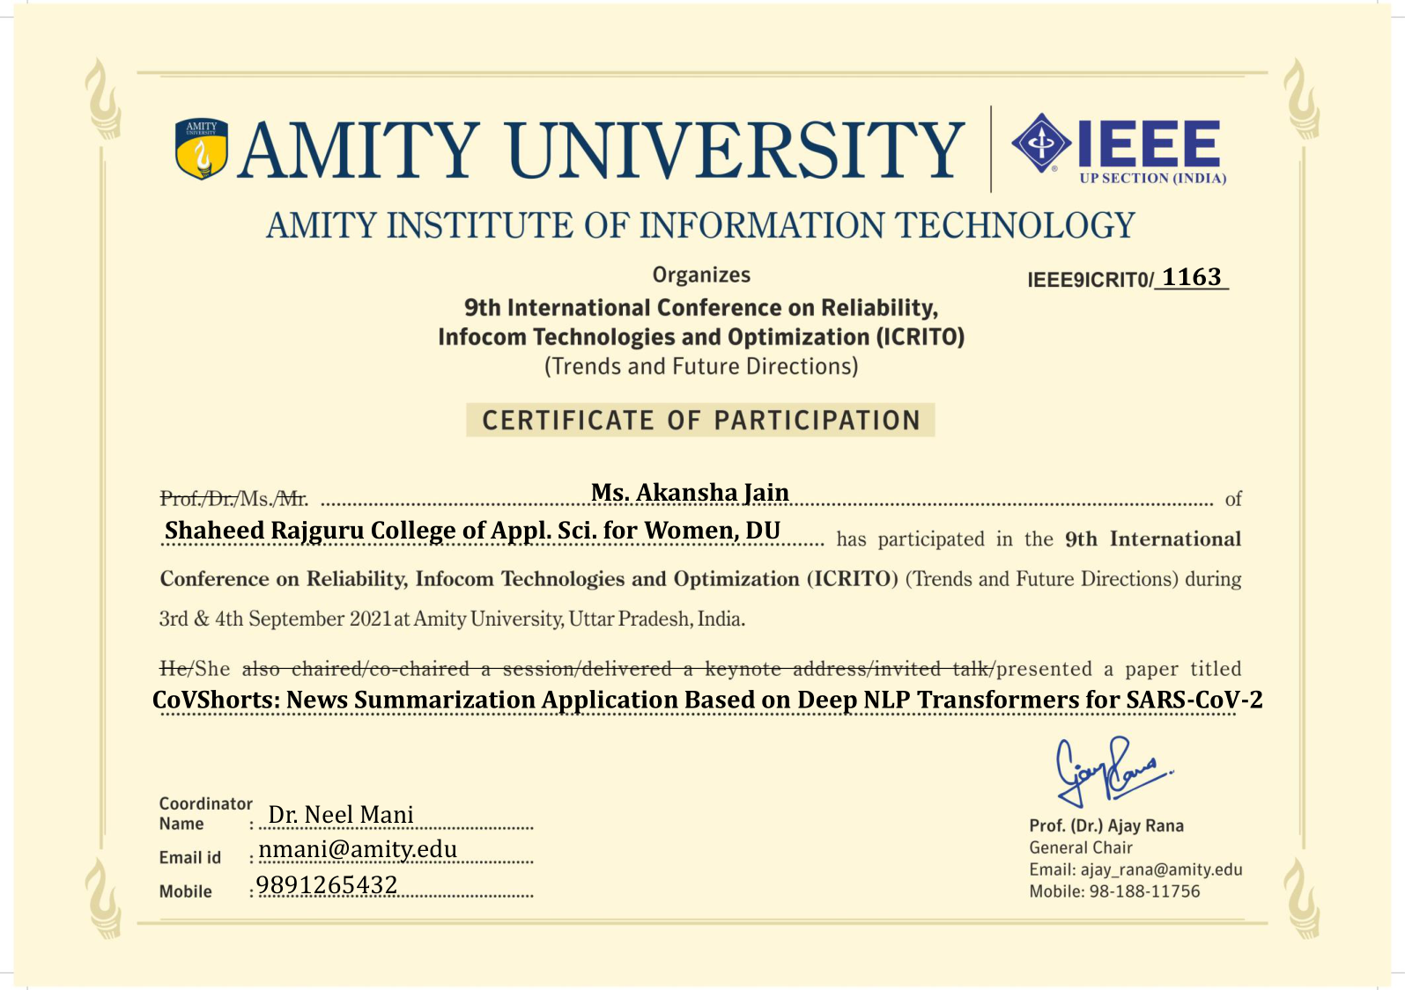
IEEE 9th International Conference on Reliability, Infocom Technologies and Optimization (ICRITO'2021)
Notes:
We have also presented our research paper titled “CoVShorts: News Summarization Application Based on Deep NLP Transformers for SARS-CoV-2” in IEEE 9th International Conference on Reliability, Infocom Technologies and Optimization, ICRITO 2021 on 4th September, 2021.

Slide 21
REFERENCES
[1] Krawcyzk, Konrad, Tadeusz Chelkowski, Swapnil Mishra, Denise Xifara, Benjamin Gibert, Daniel Joseph Laydon, Seth Flaxman et al. "Quantifying the online news media coverage of the COVID-19 pandemic." medRxiv (2020).
[2] Sethi, Prakhar, Sameer Sonawane, Saumitra Khanwalker, and R. B. Keskar. "Automatic text summarization of news articles." In 2017 International Conference on Big Data, IoT and Data Science (BID), pp. 23-29. IEEE, 2017.
[3] Miller, Derek. "Leveraging BERT for extractive text summarization on lectures." arXiv preprint arXiv:1906.04165 (2019).
[4] Lin, Chin-Yew. "Rouge: A package for automatic evaluation of summaries." In Text summarization branches out, pp. 74-81. 2004.
[5] Nallapati, Ramesh, Bowen Zhou, Caglar Gulcehre, and Bing Xiang. "Abstractive text summarization using sequence-to-sequence rnns and beyond." arXiv preprint arXiv:1602.06023 (2016).
[6] Vaswani, Ashish, Noam Shazeer, Niki Parmar, Jakob Uszkoreit, Llion Jones, Aidan N. Gomez, Lukasz Kaiser, and Illia Polosukhin. "Attention is all you need." arXiv preprint arXiv:1706.03762 (2017).
[7] Hayatin, Nur, Kharisma Muzaki Ghufron, and Galih Wasis Wicaksono. "Summarization of COVID-19 news documents deep learning-based using transformer architecture." Telkomnika 19, no. 3 (2021).
[8] Velavan, Thirumalaisamy P., and Christian G. Meyer. "The COVID‐19 epidemic." Tropical medicine & international health 25, no. 3 (2020): 278.
[9] “COVID-19 research update: How many pandemic papers have been published?” IOP Publishing NatureIndex https://www.natureindex.com/news-blog/how-coronavirus-is-changing-research-practices-and-publishing (Accessed 4th July 2021).
[10] Liu, Yang, and Mirella Lapata. "Text summarization with pretrained encoders." arXiv preprint arXiv:1908.08345 (2019).
[11] Janna Lipenkova “The COVID-19 Public Media Dataset by Anacode” https://www.kaggle.com/jannalipenkova/covid19-public-media-dataset (Accessed 7th June 2021)
[12] Ruhwinaningsih, Lira, and Taufik Djatna. "A sentiment knowledge discovery model in Twitter’s TV content using stochastic gradient descent algorithm." TELKOMNIKA (Telecommunication Computing Electronics and Control) 14, no. 3 (2016): 1067-76.
[13] Sundermeyer, Martin, Ralf Schlüter, and Hermann Ney. "LSTM neural networks for language modeling." In Thirteenth annual conference of the international speech communication association. 2012.
[14] Devlin, Jacob, Ming-Wei Chang, Kenton Lee, and Kristina Toutanova. "Bert: Pre-training of deep bidirectional transformers for language understanding." arXiv preprint arXiv:1810.04805 (2018).
[15] Radford, Alec, Jeffrey Wu, Rewon Child, David Luan, Dario Amodei, and Ilya Sutskever. "Language models are unsupervised multitask learners." OpenAI blog 1, no. 8 (2019): 9.
[16] Lample, Guillaume, and Alexis Conneau. "Cross-lingual language model pretraining." arXiv preprint arXiv:1901.07291 (2019).
[17] Yang, Zhilin, Zihang Dai, Yiming Yang, Jaime Carbonell, Ruslan Salakhutdinov, and Quoc V. Le. "Xlnet: Generalized autoregressive pretraining for language understanding." arXiv preprint arXiv:1906.08237 (2019).
[18] Raffel, Colin, Noam Shazeer, Adam Roberts, Katherine Lee, Sharan Narang, Michael Matena, Yanqi Zhou, Wei Li, and Peter J. Liu. "Exploring the limits of transfer learning with a unified text-to-text transformer." arXiv preprint arXiv:1910.10683 (2019).
[19] Xue, Linting, Noah Constant, Adam Roberts, Mihir Kale, Rami Al-Rfou, Aditya Siddhant, Aditya Barua, and Colin Raffel. "mT5: A massively multilingual pre-trained text-to-text transformer." arXiv preprint arXiv:2010.11934 (2020).
[20] Lewis, Mike, Yinhan Liu, Naman Goyal, Marjan Ghazvininejad, Abdelrahman Mohamed, Omer Levy, Ves Stoyanov, and Luke Zettlemoyer. "Bart: Denoising sequence-to-sequence pre-training for natural language generation, translation, and comprehension." arXiv preprint arXiv:1910.13461 (2019).
[21] Grinberg, Miguel. Flask web development: developing web applications with python. " O'Reilly Media, Inc.", 2018.
[22] Louis, Annie, and Ani Nenkova. "Automatically assessing machine summary content without a gold standard." Computational Linguistics 39, no. 2 (2013): 267-300.
[23] Kavita Ganesan, “An intro to ROUGE, and how to use it to evaluate summaries”, https://www.freecodecamp.org/news/what-is-rouge-and-how-it-works-for-evaluation-of-summaries-e059fb8ac840/ (Accessed 26th June 2021)
[24] Heimerl, Florian, Steffen Lohmann, Simon Lange, and Thomas Ertl. "Word cloud explorer: Text analytics based on word clouds." In 2014 47th Hawaii International Conference on System Sciences, pp. 1833-1842. IEEE, 2014.

Slide 22
THANK YOU

